Slide 1

The SMEL Project
Stench monitorization and elimination project

Slide 2


Participants
Elad Cohen
https://github.com/EladCohen1

Slide 3

What is SMEL?
The SMEL Project is an IOT project that aims to assist with the management of ventilation systems. The product is an IOT device that will notify the user whenever enough gas was detected to warrant an activation of the ventilation system, It will also notify the user whenever the gas levels return to normal. Thus, allowing the user to both save energy by not overusing the ventilation system and not spend too little energy so that the room is always at a comfortable level of air quality.

Slide 4

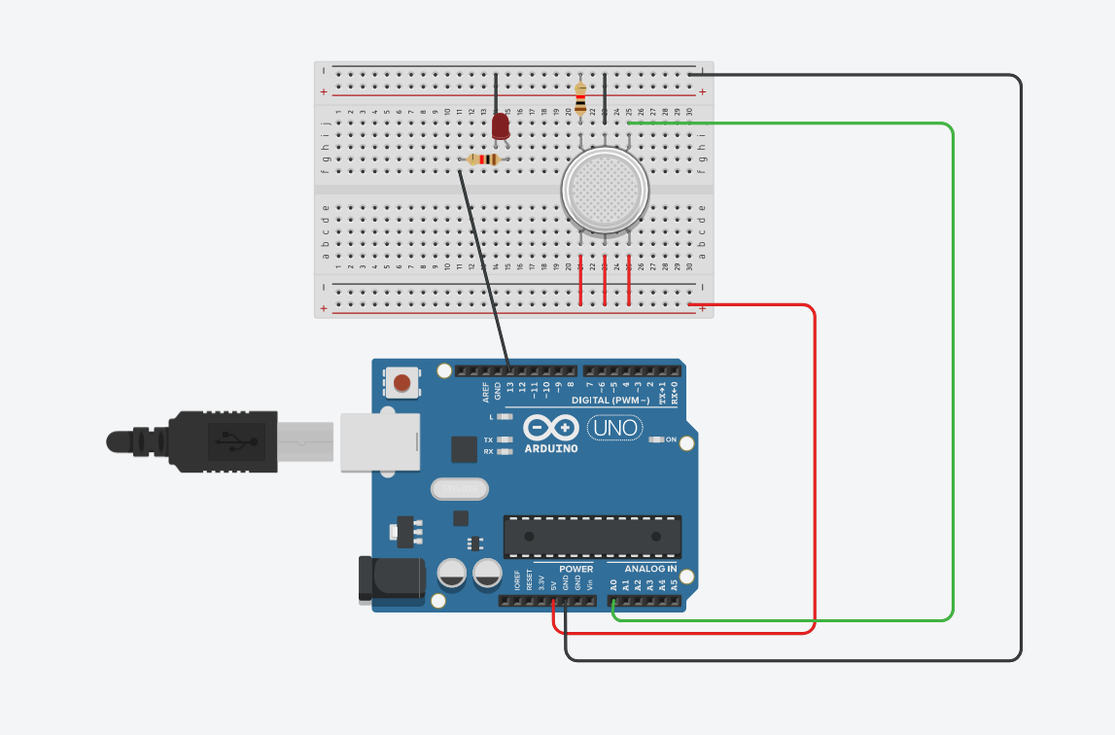
Schematics - TinkerCad
As we can see here, We connect the Arduino UNO’s 5V outlet to the bottom most row of the breadboard to make a full power row, we then connect that to the gas sensor to allow it to function. Then we connect the data outlet of the gas sensor to Arudino UNO’s A0 analog in, so that we can send that data to the cloud.
We also added an LED that we set to power on whenever gas levels rise above 250, which is our decided value for turning on the ventilation system.

Slide 5
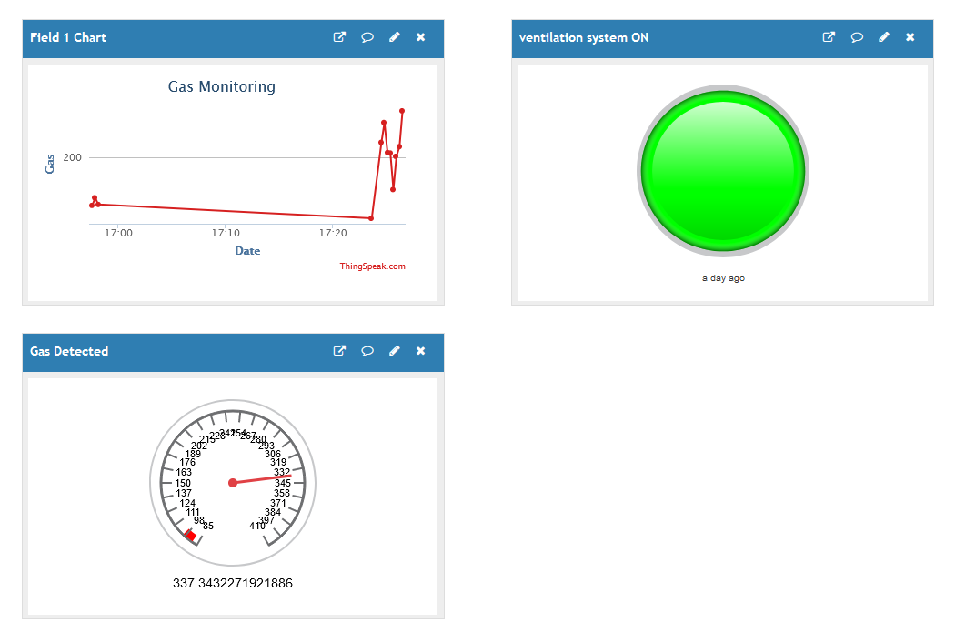
Statistics - ThingSpeak
Every 5 seconds the Arduino UNO will send data to the cloud, the data contains the gas levels detected at that moment.
We display that data using a graph of gas level by time.
For comfort of use, we also display a light that will turn on whenever the ventilation system should be turned on, and lastly, we display a gauge showing the current gas levels.

Slide 6

Want to learn more?
Visit our project’s github page here
A link to our TinkerCad project can be found here
A link to our ThingSpeak statistics can be found here
A link to our project document can be found here

